Slide 1

Programming Two (csc7051)
Aidan McGowan
Javadoc - Documentation comments
Annotations

Slide 2
Creating documentation with Javadoc
Java supports three types of comments. The first two are the // and the /* */
The third type is called a documentation comment. It begins with the character sequence /** and it ends with */
Documentation comments allow you to embed information about your program into the program itself. You can then use the javadoc utility program to extract the information and put it into an HTML file.
Documentation comments make it convenient to document your programs.

Slide 3

Documentation comments
The Javadoc tool is used to create HTML files that document Java code.
Before HTML files can be generated with the Javadoc tool, you must insert special comments – called documentation comments – into the source files.
Like other comments, documentation comments are not translated into bytecode.
Javadoc comments may contain HTML tags.

Slide 4
Placing Documentation comments
Documentation comments are placed on a line before :
  A class declaration
  An interface declaration
  A constructor
  A method
  A field (an instance variable)
  A constant

Slide 5
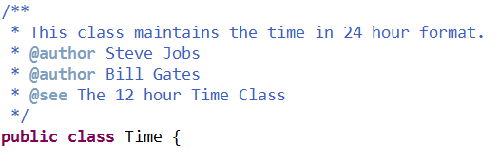
Documentation comments - Class declaration
Contains a description of the class (no limit in number of lines)
Tags @author and @see are used to specify a See Also: (related classes that may be of interest to another programmer) and an Author: note respectively in HTML documentation
It is possible to have more that one @author tag

Slide 6
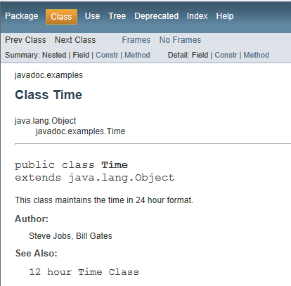
Documentation comments - Class declaration

Slide 7
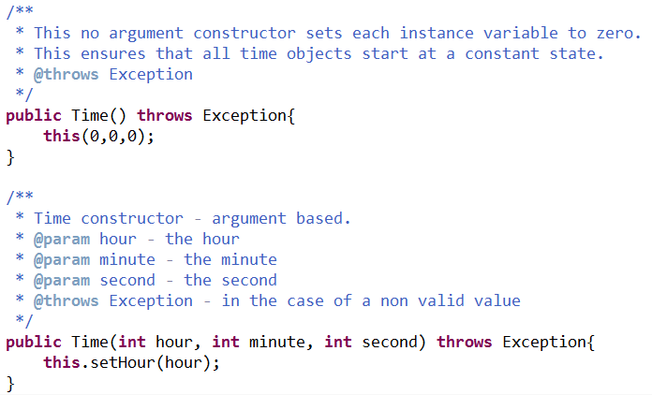
Documentation comments - Constructors

Slide 8
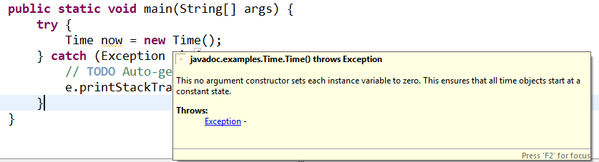
Documentation comments - Constructors
Documentation comments are visible in many IDEs during code development.

Slide 9
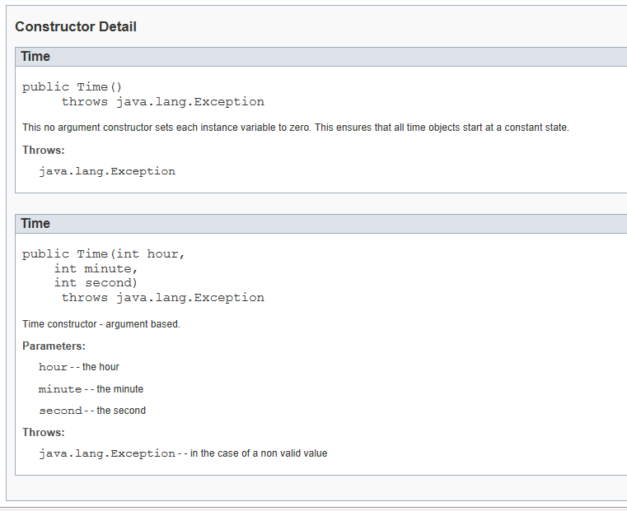
Documentation comments - Constructors
@param
@throws

Slide 10
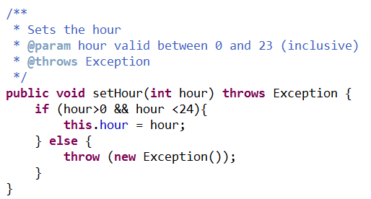
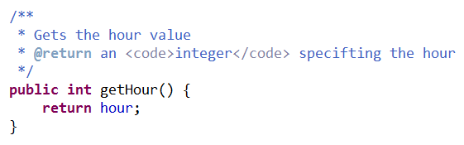
Documentation comments - methods

Slide 11
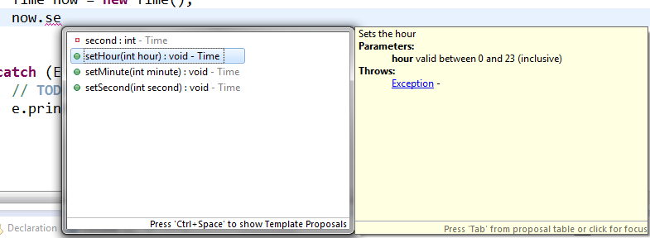
Documentation comments - methods

Slide 12
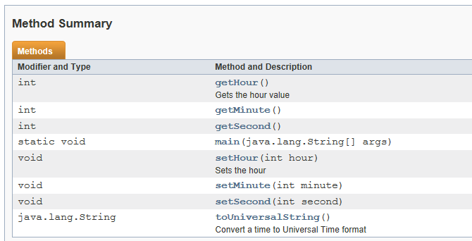
Documentation comments - methods

Slide 13
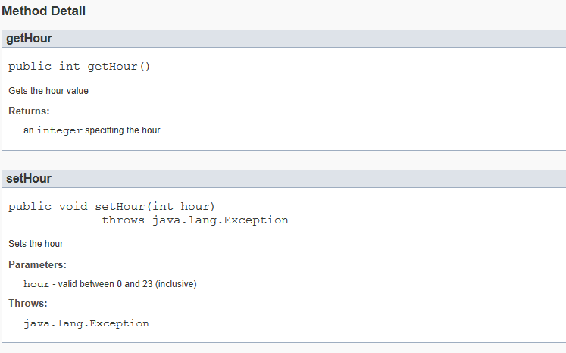
Documentation comments - methods

Slide 14
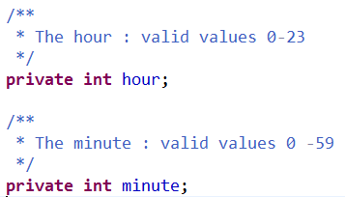
Documentation comments – Fields (instance variables)
Should be placed on the line above each instance variable declaration

Slide 15
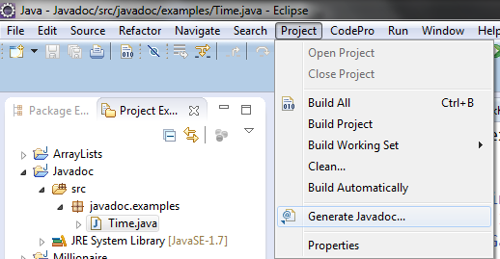
Executing the javadoc tool to create HTML documentation.
May be executed from command line ..
javadoc options packages sources @files
Or within Eclipse …

Slide 16
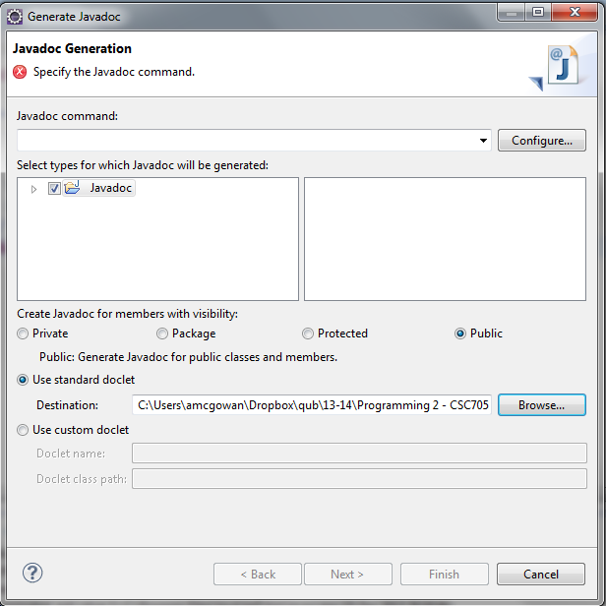
Configuring the javadoc tool
The first use of the tool may require you to configure..

Slide 17
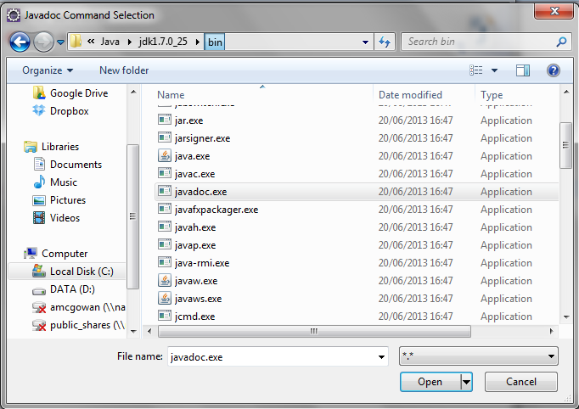
Configuring the javadoc tool
Select the location of the javadoc.exe

Slide 18
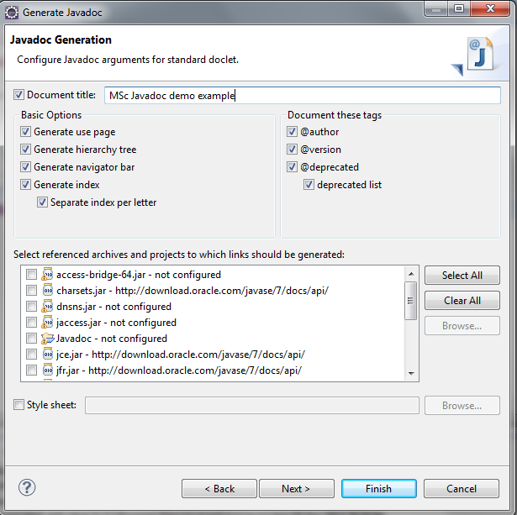
Configuring the javadoc tool
The next option includes options to include a CSS (style sheet)

Slide 19
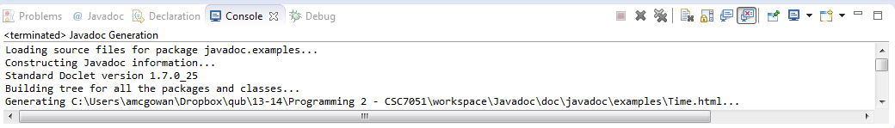
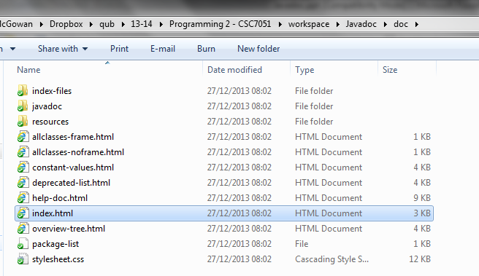
Documentation build
Building
Output files

Slide 20
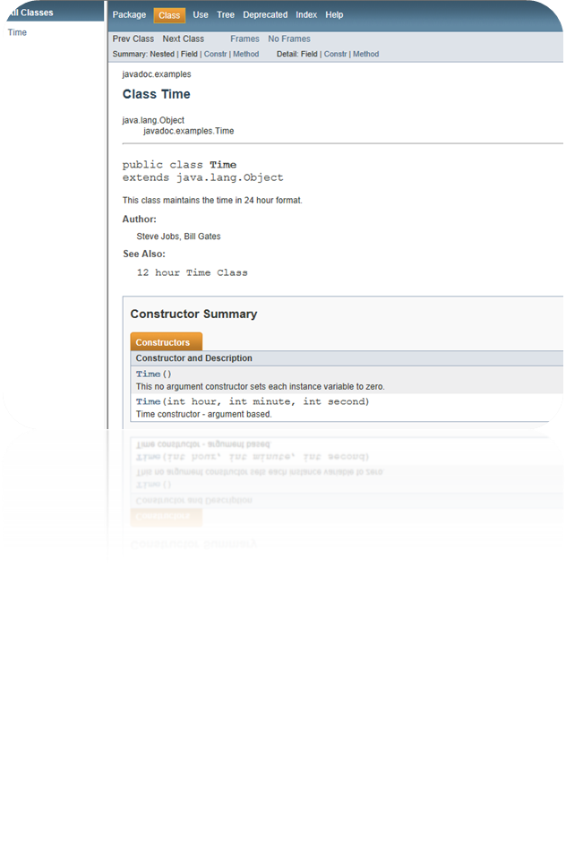
Exercise
Open the Time.java class.
Update the code to include Documentation comments for each method.
Generate and view the HTML documentation using the Javadoc tool

Slide 21
Annotations
A form of metadata
Provide data about a program that is not part of the program itself.
Annotations have no direct effect on the operation of the code they annotate.
@

Slide 22
Annotations have a number of uses, among them…
Information for the compiler — Annotations can be used by the compiler to detect errors or suppress warnings.
Compile-time and deployment-time processing — Software tools can process annotation information to generate code, XML files, and so forth.
Runtime processing — Some annotations are available to be examined at runtime.

Slide 23
The Format of an Annotation
In its simplest form, an annotation looks like the following:
@Entity
The at sign character (@) indicates to the compiler that what follows is an annotation. In the following example, the annotation's name is Override:
  @Override
  public void mySuperMethod() { ... }

Slide 24
Predefined Annotation Types
A set of annotation types are predefined in the Java API. Some annotation types are used by the Java compiler, and some apply to other annotations.
The predefined annotation types defined in java.lang are @Deprecated, @Override and @SuppressWarnings.

Slide 25
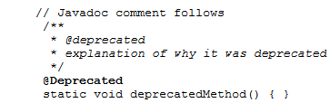
@Deprecated
Indicates that the marked element is deprecated and should no longer be used. The compiler generates a warning whenever a program uses a method, class, or field with the @Deprecated annotation. When an element is deprecated, it should also be documented using the Javadoc @deprecated tag

Slide 26
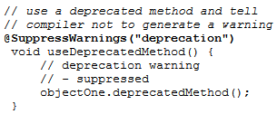
@SuppressWarnings
Tells the compiler to suppress specific warnings that it would otherwise generate. In the following example, a deprecated method is used, and the compiler usually generates a warning. In this case, however, the annotation causes the warning to be suppressed.

Slide 27

@Override
Informs the compiler that the element is meant to override an element declared in a superclass.
While it is not required to use this annotation when overriding a method, it helps to prevent errors. If a method marked with @Override fails to correctly override a method in one of its superclasses, the compiler generates an error.

